Slide 1
Team 4
Boston Real Estate Rents Analysis
Wenjin Cao
Jianxing Lu
Qiaomin Ling
Notes:
Our project is about Boston rents analysis.

Slide 2
Project Description
In our project, we can predict rents in Boston based on different arguments such as number of bedrooms/bathrooms, building type, location (zip code, public transportation), etc. We also did a vivid and interactive map-based visualization and analysis of Boston rents in accordance with specific neighborhoods and dates.

Slide 3
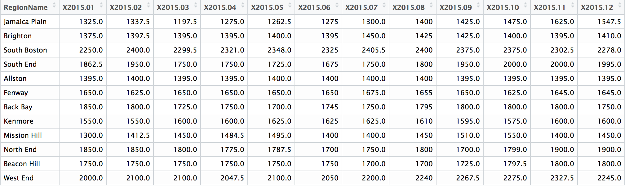
3 Kinds of Dataset Sources
(1) Zillow Data http://www.zillow.com/research/data/#rental-data We used the monthly rental data of different neighborhoods in Boston from 2013/01 to 2016/06. Parameters: Median rent (per neighborhood)
Notes:
We will start with our datasets and tools we used and then jump to the demo part.
We got 3 datasets. The first one is from zillow.com.
Those values in the table are median rents for each Boston neighborhoods of different building types, in this case, different number of bedrooms such as studio, 1bed, 2bed, 3,4, 5bed, totally 6 kinds. The time frame we chose is from January 2013 to June 2016.

Slide 4
3 Kinds of Dataset Sources
(2) Rental Data from Individual Third Party http://www.jefftk.com/apartment_prices/data-listing We used the monthly rental data of different apartments in Boston from 2013/02 to 2016/07. Parameters: Longitude and latitude of the house, number of bedrooms, rent (per house/apt).
Notes:
The second one is from another public dataset. It also has monthly rental data but they are for different apartments with coordinates and not an area.

Slide 5
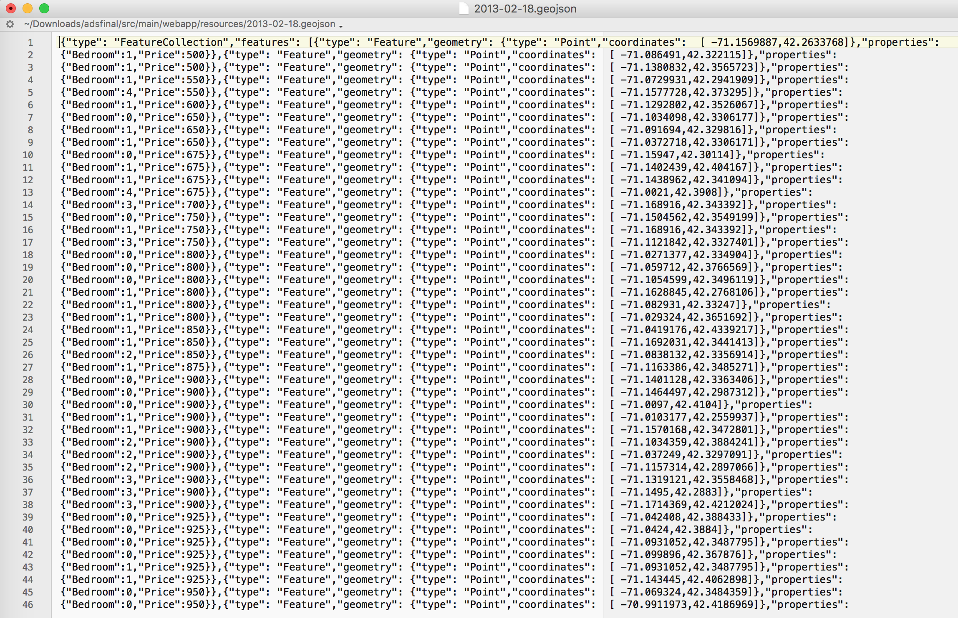
3 Kinds of Dataset Sources
(2) Rental Data from Individual Third Party http://www.jefftk.com/apartment_prices/data-listing We used the monthly rental data of different houses/apartments in Boston from 2013/02 to 2016/07. Parameters: Longitude and latitude of the house, number of bedrooms, rent (per house/apt).
Notes:
This is one of the geojson files we used. We got the data from this website and transformed them to the file type of geojson using java.

Slide 6
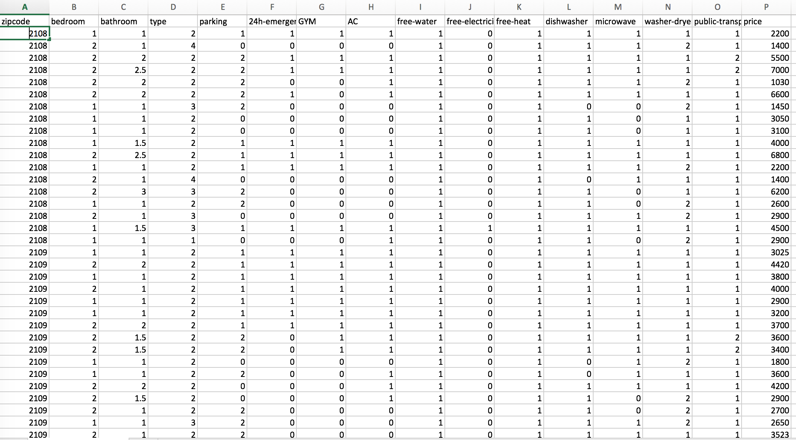
3 Kinds of Dataset Sources
(3) Manually Collected Data In order to get first-hand detailed rental information for training models, we collected data of different areas in Boston from http://www.apartments.com and http://www.zillow.com. Parameters: Zip-code, number of bedroom, number of bathroom, building type(house/apartment/condo/townhome), 24-emergency/maintenance(yes/no), GYM, AC, free-water, free-electricity, free-heat, dishwasher, microwave, washer-dryer, public-transportation (walking time to nearest transit/subway/commuter rail).
Dataset size: Over 600 rows.
Notes:
The last dataset is our manually collected data. It has over 600 rows with detailed rental information. It has zip code, number of rooms, with GYM or not, with AC or not, free water or not, et cetera. We got them from zillow.com and apartments.com. This dataset is good for building models and prediction.

Slide 7
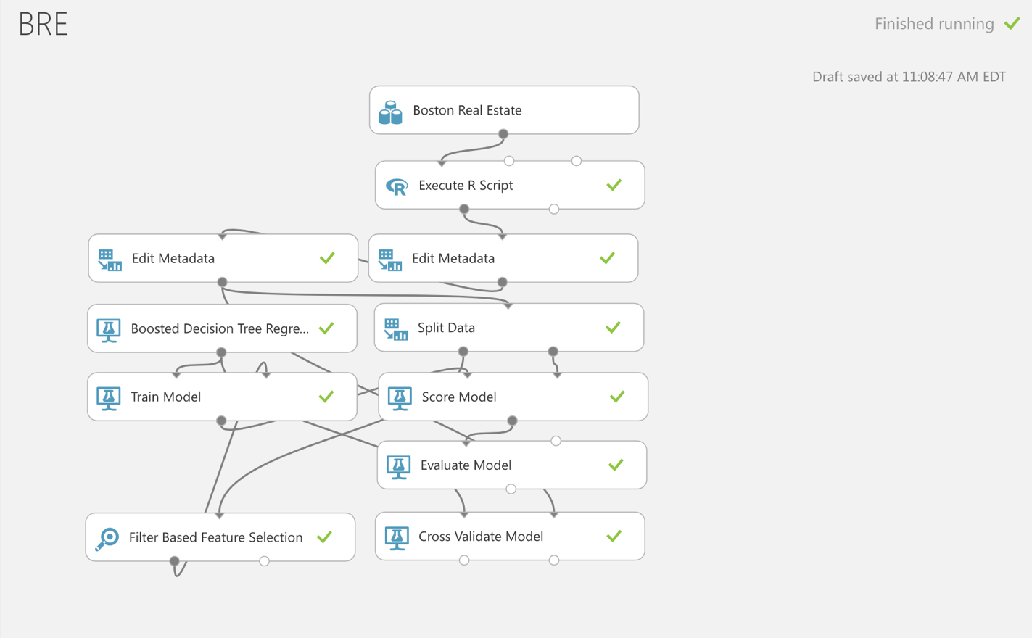
3 Tools We Used:
(1) Azure Studio We compared different regression models and deployed 2 web service. One is for quick prediction in our web application, the other is for advanced prediction.
Notes:
And here are the tools we used. In azure studio,

Slide 8
3 Tools We Used:
Azure Studio We compared different regression models deployed 2 web service. One is for quick prediction in our web application, the other is for advanced prediction.
Price ~ zip + bedroom + bathroom + type
 | Mean Absolute Error | Root Mean Squared Error | Relative Absolute Error | Relative Squared Error | Coefficient of determination(R²)
Boosted Decision Tree Regression | 575 | 888 | 0.59 | 0.45 | 0.55
Bayesian Linear Regression | 616 | 899 | 0.63 | 0.45 | 0.55
Decision Forest Regression | 619 | 967 | 0.63 | 0.52 | 0.47
Linear Regression | 613 | 891 | 0.62 | 0.44 | 0.56
Neural Network Regression | 1777 | 2061 | 1.84 | 2.55 | -1.55
Poisson Regression | 769 | 1080 | 0.78 | 0.63 | 0.37
Fast Forest Quantile Regression | Average Quantile Loss: 318
Price ~ zip + bedroom + bathroom + type + 24-emergency/maintenance + GYM + AC + free-water + free-electricity + free-heat + dishwasher + microwave + washer-dryer + public-transportation
 | Mean Absolute Error | Root Mean Squared Error | Relative Absolute Error | Relative Squared Error | Coefficient of determination(R²)
Boosted Decision Tree Regression | 556 | 841 | 0.57 | 0.40 | 0.60
Bayesian Linear Regression | 591 | 866 | 0.60 | 0.42 | 0.58
Decision Forest Regression | 602 | 918 | 0.61 | 0.46 | 0.54
Linear Regression | 498 | 878 | 0.61 | 0.43 | 0.57
Neural Network Regression | 1770 | 2054 | 1.83 | 2.54 | -1.54
Poisson Regression | 657 | 960 | 0.67 | 0.51 | 0.49
Fast Forest Quantile Regression | Average Quantile Loss: 286
Notes:
Here are the performance metrics of different models for predicting rent price.

Slide 9
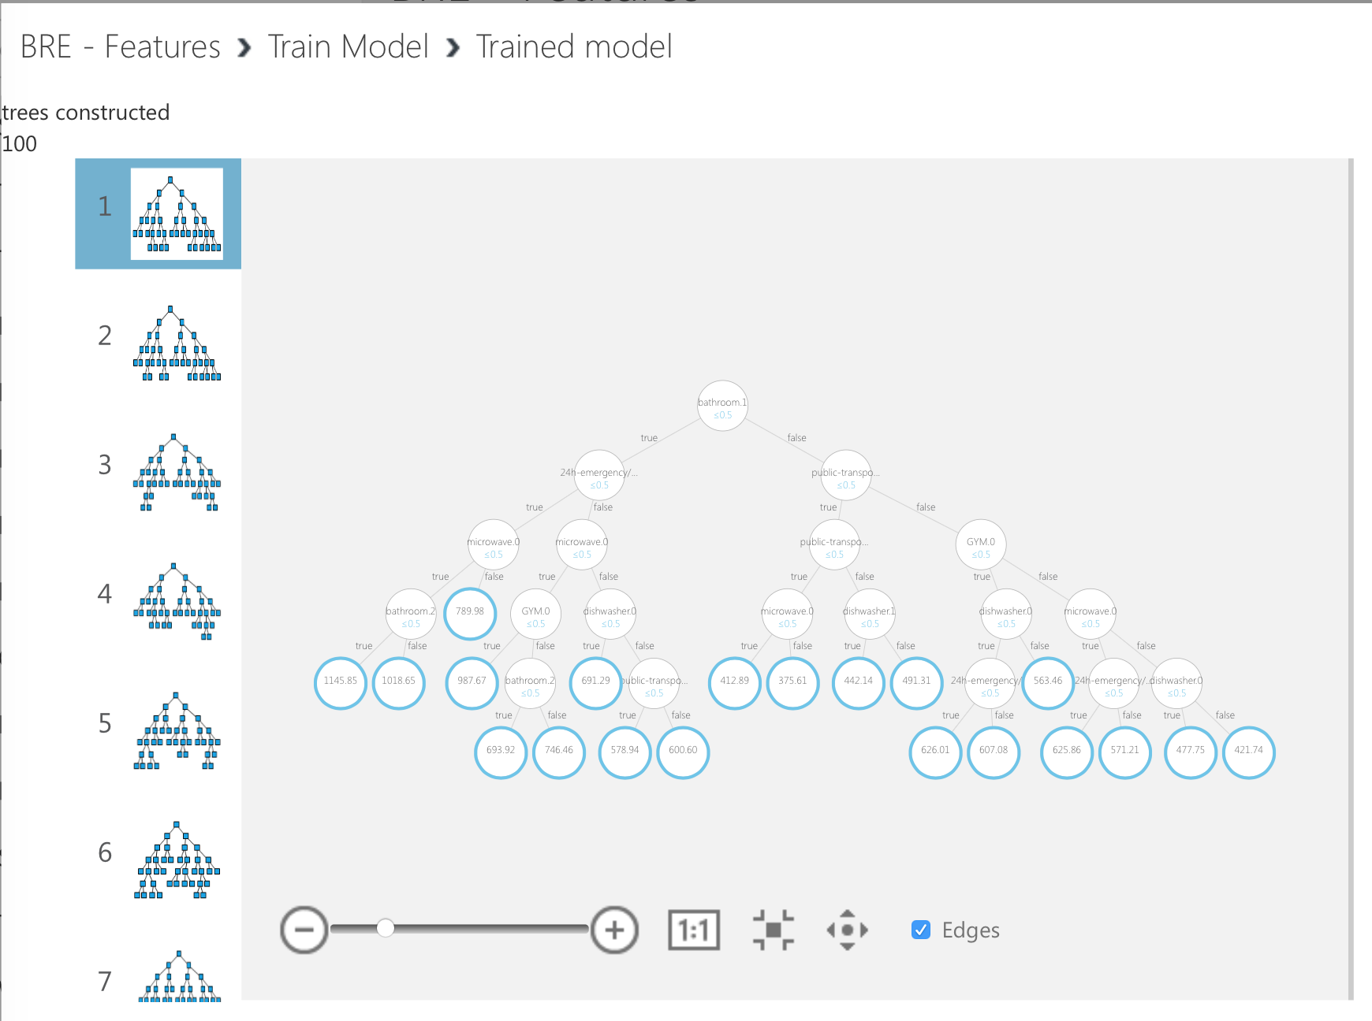
3 Tools We Used:
Azure Studio We compared different regression models deployed 2 web service. One is for quick prediction in our web application, the other is for advanced prediction.
Price ~ zip + bedroom + bathroom + type
 | Mean Absolute Error | Root Mean Squared Error | Relative Absolute Error | Relative Squared Error | Coefficient of determination(R²)
Boosted Decision Tree Regression | 575 | 888 | 0.59 | 0.45 | 0.55
Bayesian Linear Regression | 616 | 899 | 0.63 | 0.45 | 0.55
Decision Forest Regression | 619 | 967 | 0.63 | 0.52 | 0.47
Linear Regression | 613 | 891 | 0.62 | 0.44 | 0.56
Neural Network Regression | 1777 | 2061 | 1.84 | 2.55 | -1.55
Poisson Regression | 769 | 1080 | 0.78 | 0.63 | 0.37
Fast Forest Quantile Regression | Average Quantile Loss: 318
Price ~ zip + bedroom + bathroom + type + 24-emergency/maintenance + GYM + AC + free-water + free-electricity + free-heat + dishwasher + microwave + washer-dryer + public-transportation
 | Mean Absolute Error | Root Mean Squared Error | Relative Absolute Error | Relative Squared Error | Coefficient of determination(R²)
Boosted Decision Tree Regression | 556 | 841 | 0.57 | 0.40 | 0.60
Bayesian Linear Regression | 591 | 866 | 0.60 | 0.42 | 0.58
Decision Forest Regression | 602 | 918 | 0.61 | 0.46 | 0.54
Linear Regression | 498 | 878 | 0.61 | 0.43 | 0.57
Neural Network Regression | 1770 | 2054 | 1.83 | 2.54 | -1.54
Poisson Regression | 657 | 960 | 0.67 | 0.51 | 0.49
Fast Forest Quantile Regression | Average Quantile Loss: 286
Notes:
We used the Boosted Decision Tree Regression model for both web services.

Slide 10
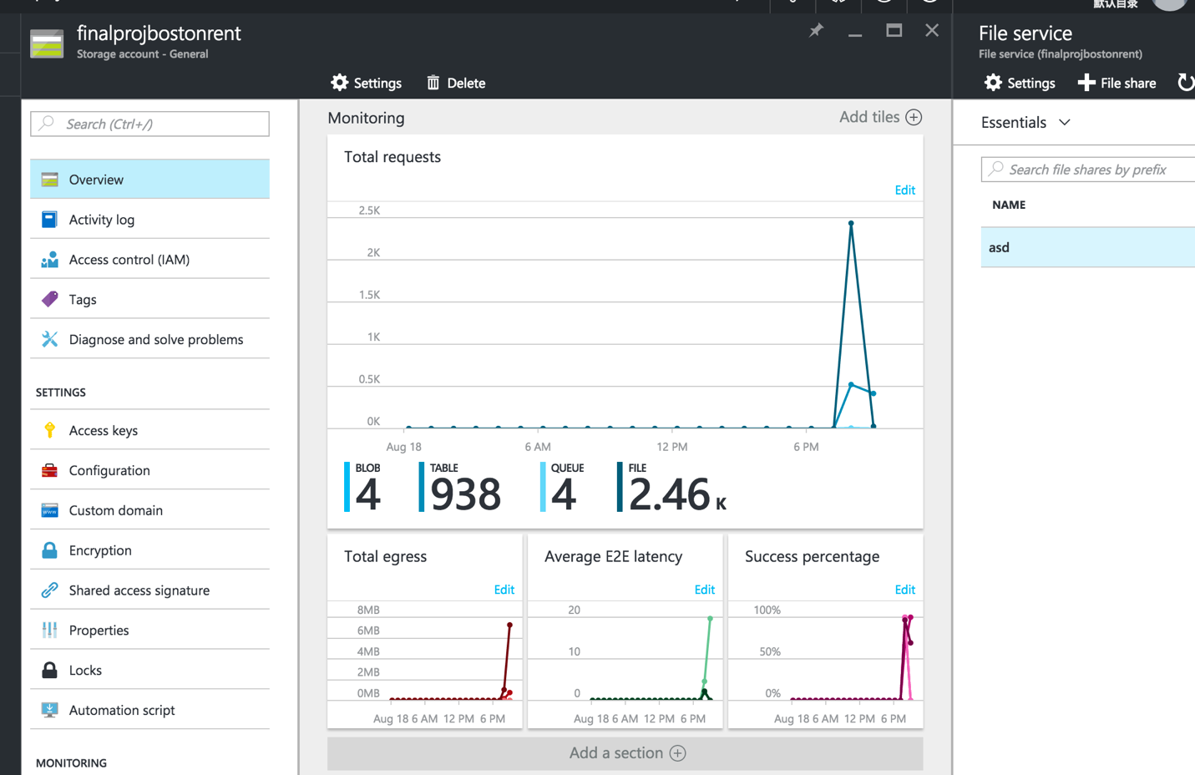
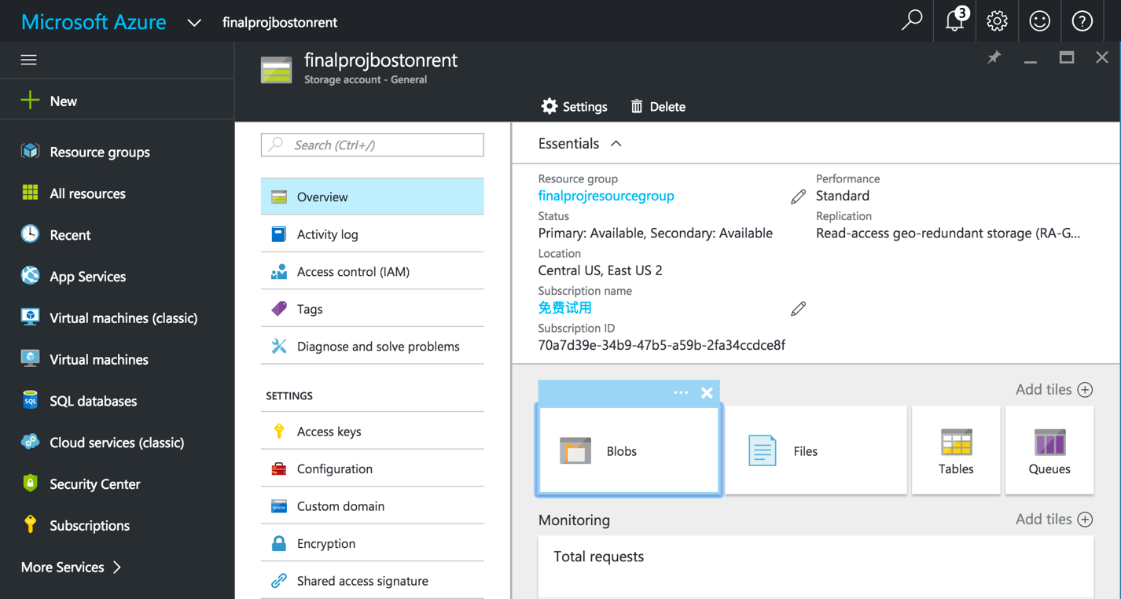
3 Tools We Used:
(2) Azure Portal We stored the geojson files we mentioned before using Azure File Storage Service.
Notes:
In Azure Portal, we stored the geojson files I mentioned before using Azure File Storage Service.

Slide 11
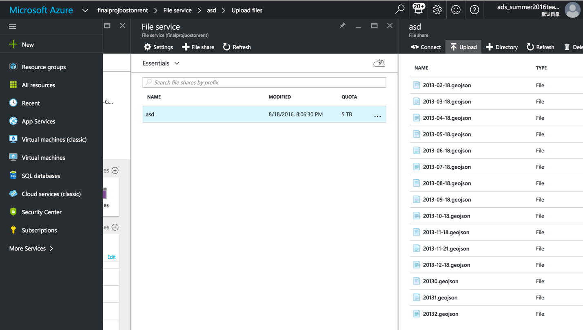
3 Tools We Used:
(2) Azure Portal We stored the geojson files we mentioned before using Azure File Storage Service.
Notes:
It looks like this.

Slide 12
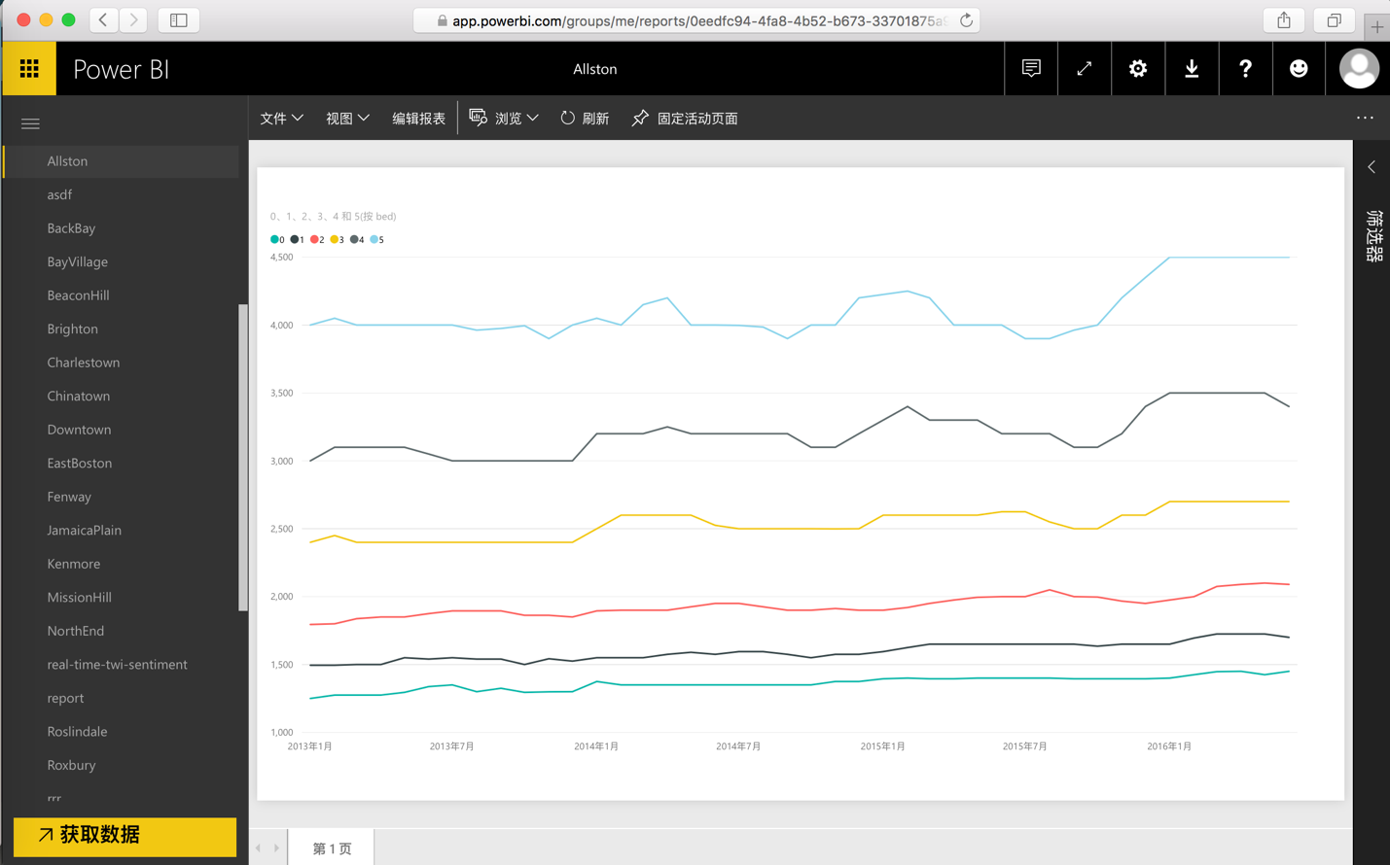
3 Tools We Used:
(3) Power BI
Notes:
We also used power bi for visualization. We plotted graphs for each neighborhood in Boston. Here It shows median monthly rents for apartments with different number of bedrooms. There are data of 4 years form 2013 to 2016.
Now we are ready to go to the demo part.

Slide 13

Web application
http://adsfinalproject.xigtazbqwr.us-east-1.elasticbeanstalk.com/

